Slide 1



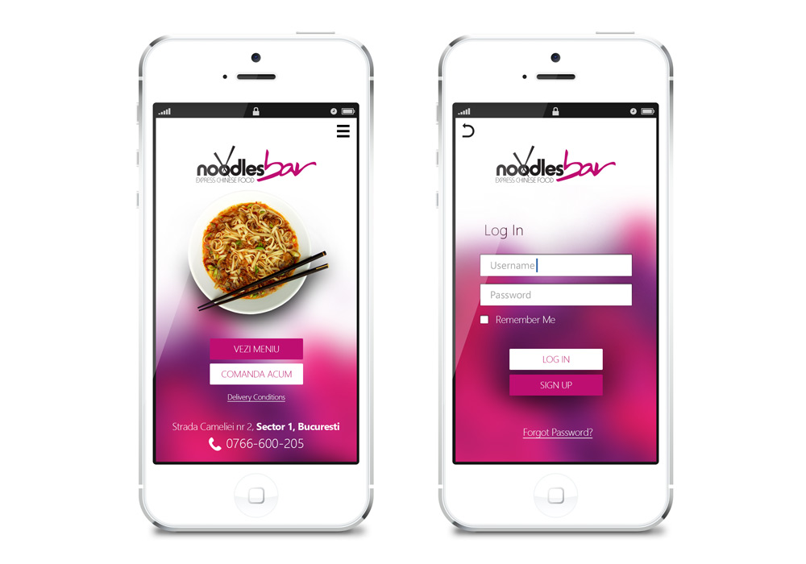
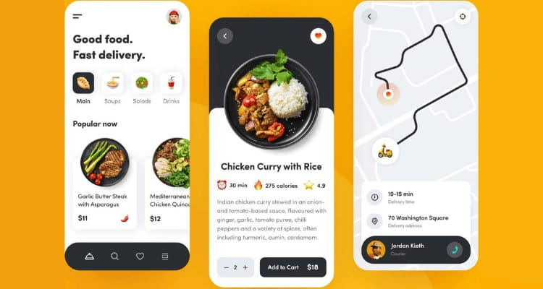
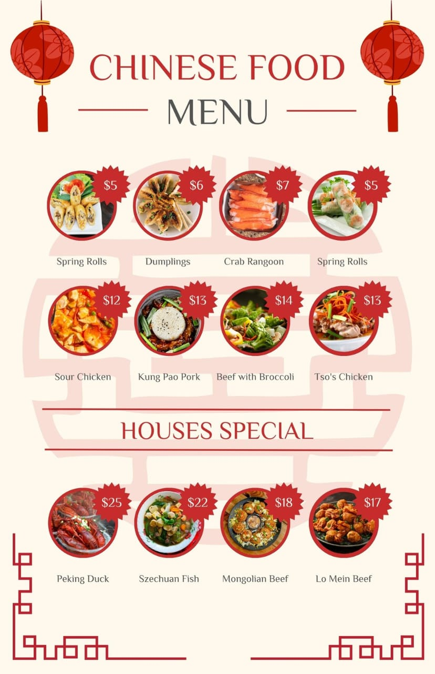
WOK AND DRAGON FOODS
APP DESIGN
HOTEL POSTER
PLACE ORDER AND TRACK
SIGN IN PAGE
SELECT THE FOOD

